Slide 1

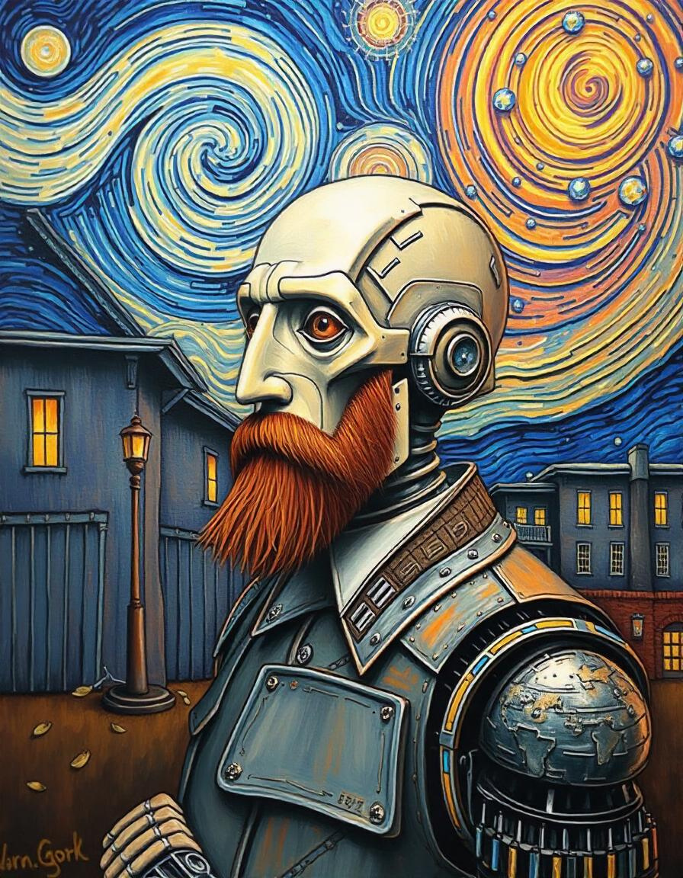
Artificial Vincent
Van Gogh
Our ideal goal is to create new and unique images of Christianity that embody Van Gogh's later style and expression.

Slide 2
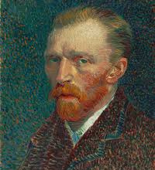
Project
Overview
Our project leverages the power of GANs & Neural Style
Transfer to analyze and learn from a comprehensive data
set of Van Gogh's paintings. By training on this data, our model
aims to generate new, unique Style images that
capture the essence of Van Gogh's post-
impressionist style, including his bold color choices,
expressive brushstrokes, and emotive compositions.

Slide 3
Project Levels
Data Collection
Data Preprocessing
This section outlines our data collection process. we collect fake & real data.
This section outlines our data collection process,
Building Model
Interface
Tdesigned to capture and reproduce the unique stylistic elements of Van Gogh's artwork.
an interface to interact with model in an
interactive way and display the results.

Slide 4
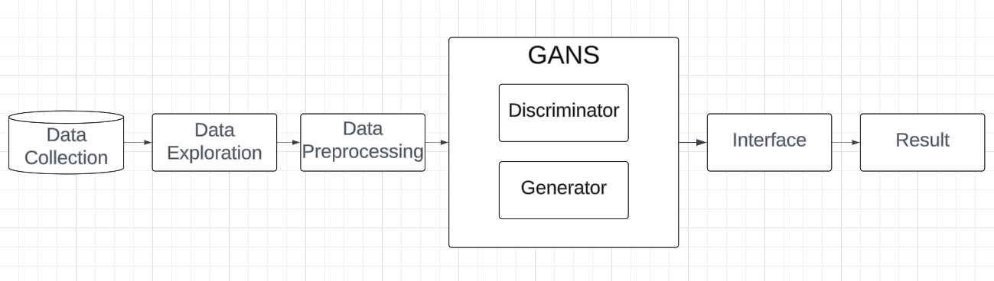
Project Levels

Slide 5
Data Collection
Van Gogh Museum
Amsterdam: Provided high-resolution images of their extensive collection.
Google Arts & Culture
Provided access to high-quality images from various museums worldwide.
The official Van Gogh project While primarily textual, sketches and paintings mentioned in Van Gogh's correspondence.
The Complete Paintings
by Ingo F. Walther and Rainer Metzger: Used for cross-referencing and filling gaps in digital sources.

Slide 6
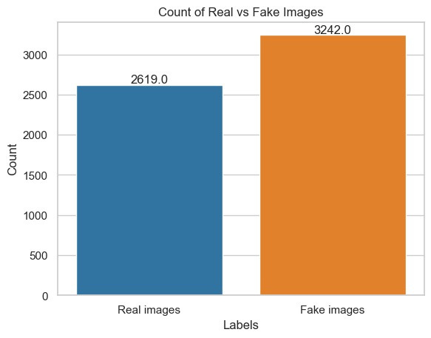
Data Exploration
This bar chart shows the distribution of real versus fake images in a dataset, with counts for each category. Here's a breakdown of the key elements and an exploration based on this data:
-Real Images: 3274
- train: 2,619
- test: 655
-Fake images: 3,242

Slide 7
Data Preprocessing
Stage 1
Segmentation
Resized all images to Converted
all images (64 x 64) to RGB format
padding where necessary.
Standrization
Augmentation
Normalization
make all the images’ pixels between 0 and 1 by dividing on 255

Slide 8

GAN Model
Our project utilizes a custom Generative Adversarial Network (GAN) architecture designed specifically to capture and reproduce the unique stylistic elements of Van Gogh's artwork. This section details the overall architecture and the specific designs of the generator and discriminator networks.
Generator Network Design
Discriminator Network Design
View More

Slide 9
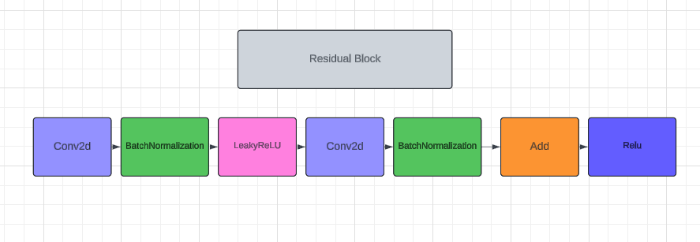
Generator

Slide 10
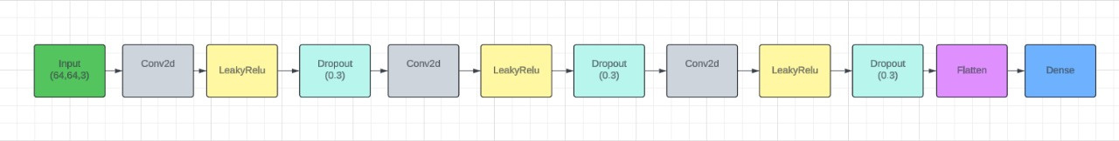
Discriminator

Slide 11
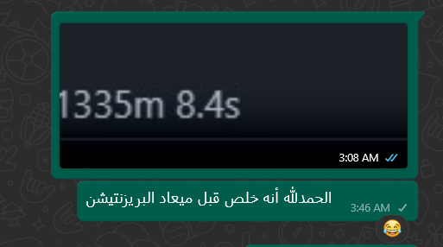
Training Process
Discriminator Training:
Train on a batch of real images (label: 1).
Train on pre-existing fake images (label: 0).
Generator Training:
Generate new images and train with labels as real (1.0), aiming to
fool the Discriminator.
Evaluation & Checkpointing:
Save Generated Images: Save sample images at regular intervals.
Model Checkpoints: Save model weights every 2000 epochs to allow resuming training.
Monitor Losses: Track Discriminator and Generator losses throughout the process.
Training Duration:
Train for 6100 epochs with a batch size of 64, allowing the model to improve over time.

Slide 12
Interface
we created an User interface (UI) for an application related to artificial style transfer & GANS based on Vincent Van Gogh's artwork to interact with our model that built-in Dash & Keras.

Slide 13
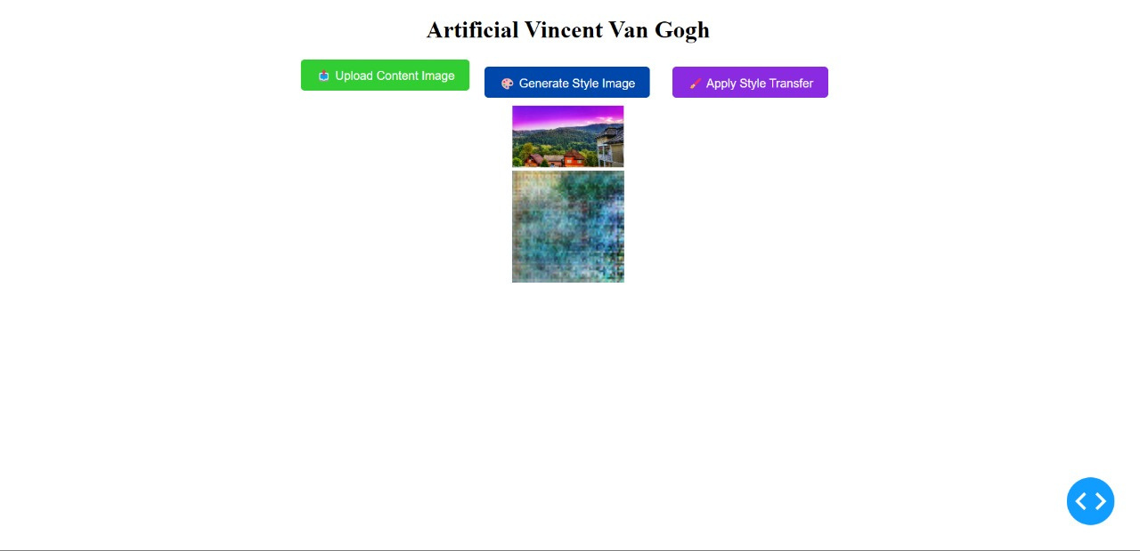
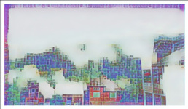
Interface

Slide 14
Future Work
Fix the bug that exist in the function process in the interface
try to change the model to make more variety
try different data sets

Slide 15
Team Members
Youssef Husseiny
Boules Ashraf
Abdallah Beshary
Shahd Alaa
Mariam Safwat
Mahmoud Abdelawal

Slide 16
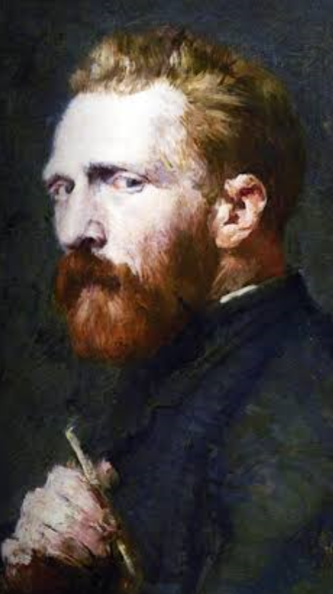
Quote
“What would life be
if we had no courage
to attempt anything ?”
Vincent Van Gogh

Slide 17
Thank You

